Slide 2
Why did we carry out the survey?
To find out what people think of Cambuslang – starting point for developing a new Community Strategy
Survey questions:
What do you like about Cambuslang?
What do you not like about Cambuslang?
What do you think are the most important changes needed?
Where do you get most of your information on what’s happening?
Are you involved in any clubs, associations, churches or other groups?
Are you interested in being involved in any community?
How long have you lived in Cambuslang?

Slide 3
Who responded to the survey?
1,090 respondents – breakdown by gender and age
Male
17-65

Slide 4
What do people like about Cambuslang?

Slide 5
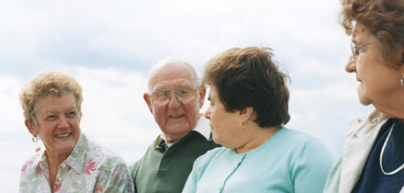
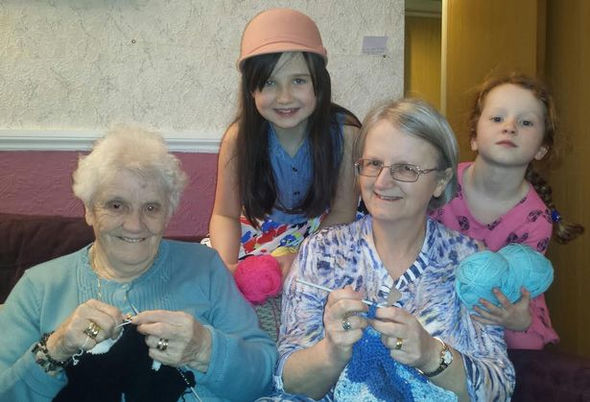
Cambuslang – a friendly town
Cambuslang has strong community networks
Almost half of respondents are involved in clubs, church groups or associations
“Cambuslang people are friendly - everyone in the old community knows their neighbours and looks out for each other.”

Slide 6
How long have people lived in Cambuslang?

Slide 7
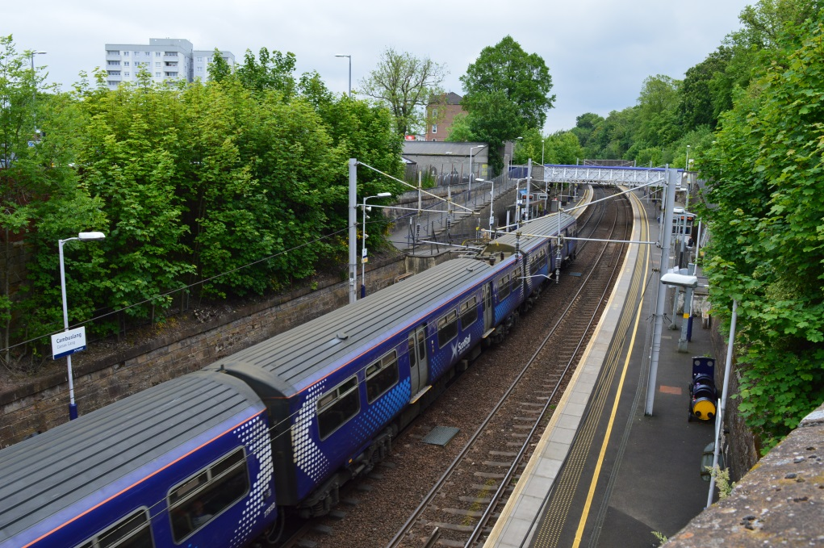
Accessibility is good
Good transport connections:
two stations
frequent rail services
several bus services
proximity to the M74
But…
there are problems with services to EK
also from Newton, Whitlawburn to town centre

Slide 8
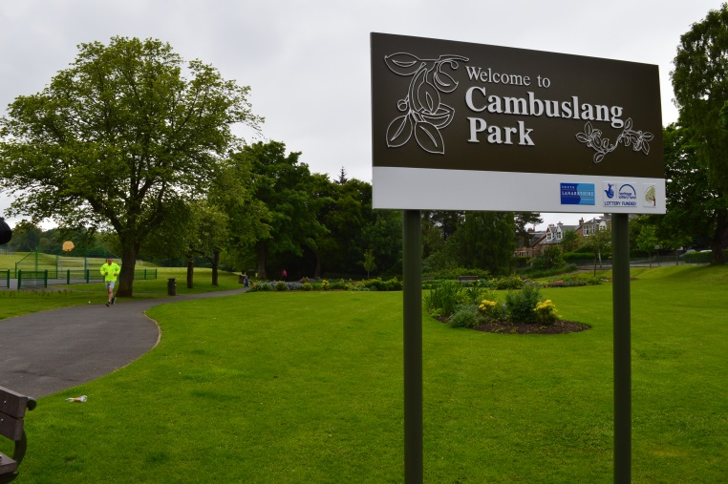
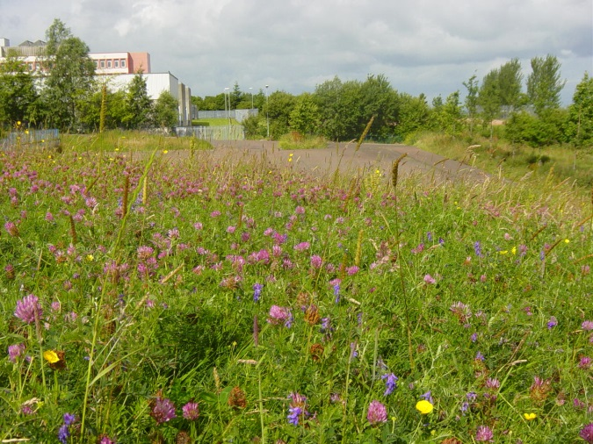
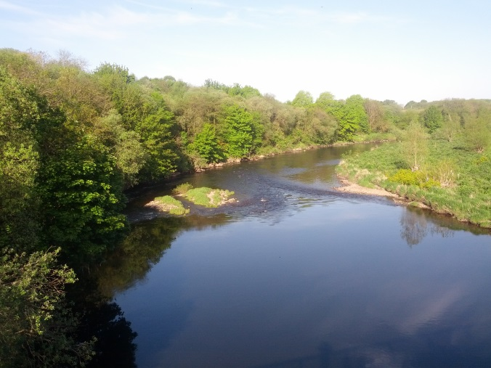
Green environment is valued
Praise for the parks and the efforts to improve them….
…but concern over threats to greenspace from development

Slide 9
Green environment is valued
Praise for the parks and the efforts to improve them….
…but concern over threats to greenspace from development
“Parks are crucial but always are an afterthought by councils and developers. And it is left to well-meaning people in the community giving their time to maintain those dear green spaces.”

Slide 10
What do people not like about Cambuslang?

Slide 11
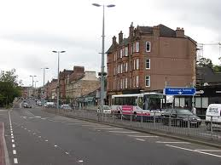
Main Street layout is ‘a mistake’
Crossings are confusing or dangerous
Service road is easily blocked
Lack of passing trade – no impulse purchases
Quality of pavement is poor

Slide 12
Main Street layout is ‘a mistake’
Crossings are confusing or dangerous
Service road is easily blocked
Lack of passing trade – no impulse purchases
Quality of pavement is poor
“I think that for both people driving and walking the roads are not very cleverly thought out. There is a lack of places to cross the street, and too few parking and drop-off points on the Main Street for the size of community and its facilities.”

Slide 13
Parking – a ‘huge problem’
Parking time of 30min is too short – shops are losing custom
Traffic wardens ‘over-zealous’
Bigger problem: Cambuslang has become a park-and-ride town for commuters

Slide 14
Parking – a ‘huge problem’
Parking time of 30min too short – shops losing custom
Traffic wardens ‘over-zealous’
Bigger problem: Cambuslang has become a park-and-ride town for commuters
“It's hard to use local shops because on-street parking is limited and there is no scope to wait for a space, so you have to drive the long way round again. The temptation is to give up and go to the supermarket instead.”

Slide 15
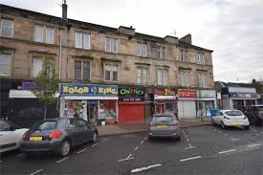
Shopping environment is ‘poor’
Range of shops is too limited
We lack a greengrocer, local supermarket and clothes/shoe shops
Relocation of post office not a good idea

Slide 16
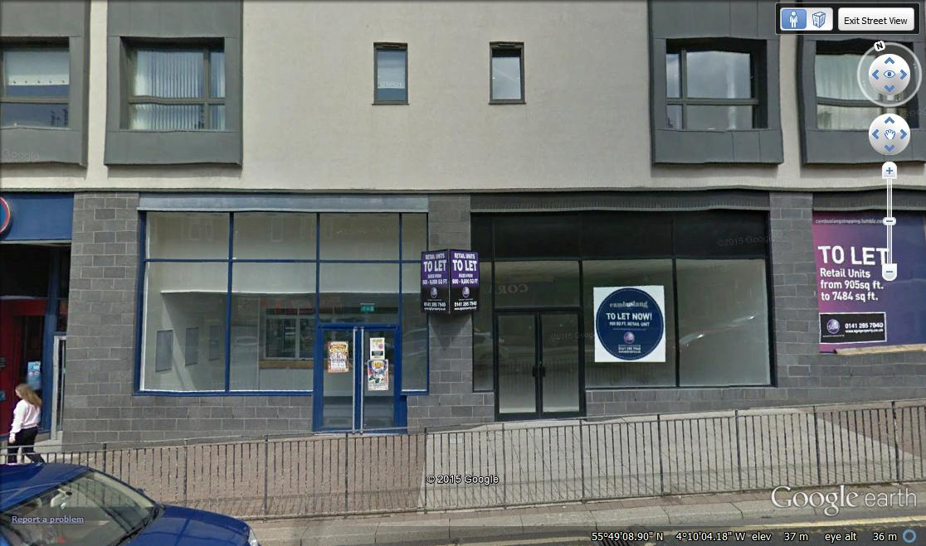
Retail environment is ‘poor’
Range of shops is too limited
We lack a greengrocer, local supermarket or clothes/shoe shops
Relocation of post office not a good idea
Number of vacant units creates a bad impression
Some units have never been let

Slide 17
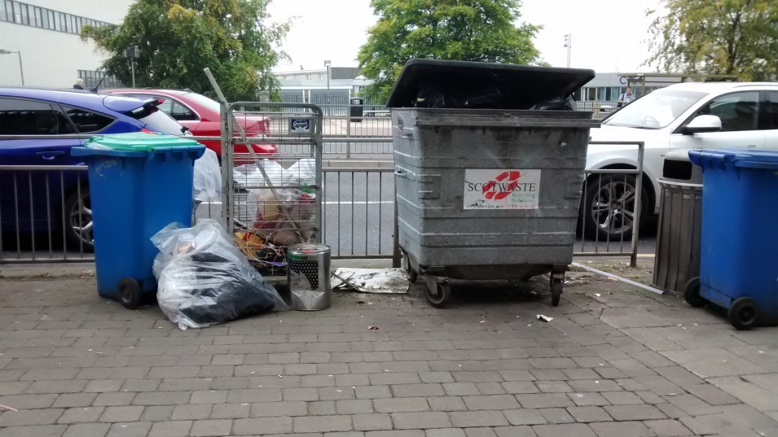
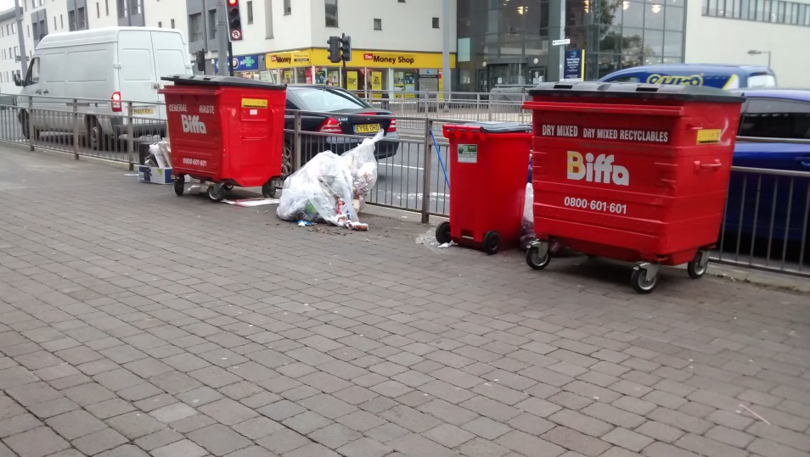
Unsightly waste bins
Major concern is bins on the Main Street – 18 trolley waste bins alone
Give a poor impression of the town centre

Slide 18
Unsightly waste bins
Major concern is bins on the Main Street – 18 trolley waste bins alone
Give a poor impression of the town centre
“Who would want to shop in a main street cluttered with smelly industrial size wheelie bins? The people of Cambuslang deserve much better than this, and removing these bins should be a priority”

Slide 19
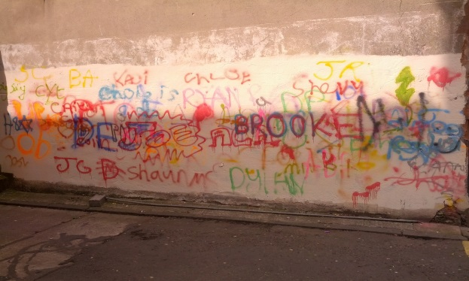
Other issues of concern
Crime and anti-social behaviour – burglaries, vandalism, graffiti, dog-fouling etc

Slide 20
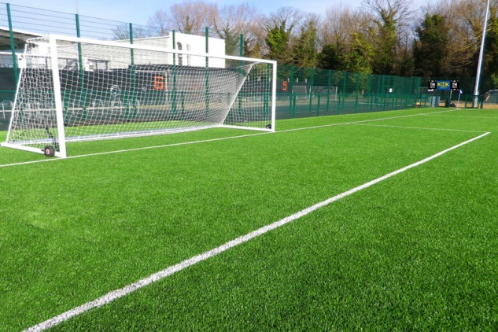
Other issues of concern
Crime and anti-social behaviour – burglaries, vandalism, graffiti, dog-fouling etc
Lack of sports and leisure facilities, especially 3G football pitch for local clubs

Slide 21
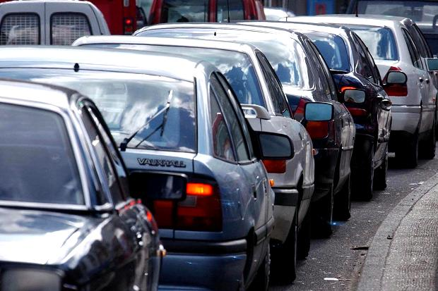
Other issues of concern
Crime and anti-social behaviour – burglaries, vandalism, graffiti, dog-fouling etc
Lack of sports and leisure facilities, especially 3G football pitch for local clubs
Traffic congestion, especially Greenlees Road and rat-runs (Johnson Drive, Brownside Road)

Slide 22
How do people find out what’s happening in Cambuslang?

Slide 23
Looking forward: priorities
Over 1,800 suggestions were made for economic, social and environmental improvements to Cambuslang.
Improve the appearance and attraction of the Main Street.
Improve and diversify the retail environment.
Address public concerns about crime.
Develop new sports/leisure facilities for different age groups.
Address public concerns about traffic congestion.
Improve the protection and provision of greenspace in the area.
Increase community engagement and cohesion.

Slide 24
Looking forward: priorities
Priority 1: Improve the appearance and attraction of the Main Street - relocate or provide shelters for waste bins provide more flowers and planters in the Main Street erect welcome signs at the entrances to Cambuslang / Main Street introduce a new parking strategy on the Main Street and associated car parks serving the needs of retailers and customers with more time for free parking ensure cleaner town centre with prompt removal of graffiti and litter improve appearance of current shops with better and standard/coherent facades disguise empty shops with artistic facades create a park-and-ride facility for commuters (also for office workers) away from the Main Street to create more space reinstate public toilets on/near the Main Street re-lay pavement with stronger base to reduce maintenance and accidents develop a new, community-based vision for the layout of the Main Street including a focal point for civic events and recreation of ‘village’ atmosphere

Slide 25
Looking forward: priorities
Priority 2: Improve and diversify the retail environment - address the vacant premises through reduced rates and promotion restrict any new pubs and takeaways where provision is already extensive prioritise uses such as family-friendly restaurants, a centrally located supermarket, fresh fruit/vegetable shops, and shoe/clothing shops
Priority 3: Address public concerns about crime - re-open police station or create an alternative local and accessible police base within the community increase police presence and visible patrols, especially in the Main Street in the evenings to reduce anti-social behaviour consider CCTV on the Main Street to reduce anti-social behaviour increase control/monitoring of litter and dog fouling

Slide 26
Looking forward: priorities
Priority 4: Develop new sports/leisure facilities - provide soft-play centre and play areas for young children in town centre provide new sports facilities serving the centre and east of Cambuslang create a 3G football pitch for local clubs expand Universal Connections to provide more facilities/activities for teenagers
Priority 5: Address public concern about traffic congestion - restrict traffic flows and reduce traffic speed on Greenlees Road establish traffic calming measures to reduce rat-run traffic in Johnson Dr/Croft Rd, Brownside Rd (especially at W.Coats School) and Stewarton Dr review layout of pedestrian crossings at Main Street junctions with West Coats Road and Greenlees Road review layout of crossing at the centre of the Main Street (as part of long-term planning of new Main Street layout)

Slide 27
Looking forward: priorities
Priority 6: Improve greenspace in the area - preserve the greenspace from development increase provision of parks and greenspace in new areas of housing develop other parks to the standard of Cambuslang Park
Priority 7: Increase community engagement and cohesion - involve community more in decisions made about the area organise more gala days and public events develop better community facilities such as a community cinema

Slide 28
Are people willing to get involved?

Slide 29
Where do we go from here?
Develop the priorities for change into a new Community Strategy - which is practical and feasible
Begin with a vision for Cambuslang that commands support from across the community
Identify a series of actions and projects over the short, medium and long terms that can translate the vision into practice
CCC propose to create a partnership with SLC, other public bodies, clubs, churches, associations, the business and voluntary sectors, and the wider community.

Slide 30
Where do we go from here?
Scottish Government has a new Town Centre Action Plan:
“we want to take every measure possible to ensure that our town centres are vibrant places”
Funding is available from a range of sources for town centre regeneration, e.g.
community projects to change first impressions
regeneration fund for large-scale capital investments
business improvement districts
specialist advice on regeneration
Scottish Government also wants local communities to be involved (Community Empowerment Scotland Act 2015)

Slide 31
Where do we go from here?
Cambuslang Community Council has already applied for £130,000 under the Town Centre Communities Capital Fund for Main Street improvements
planting – street planters, hanging baskets, barrier baskets
shelters for waste bins
repainting of railings and shutters
false facades for vacant units
welcome signs
Other projects
National Cycle Centre project for Cambuslang
New cycle path and walkway along the Clyde
Cambuslang Green Network – green streets linking the parks

Slide 32
Questions for discussion
What do you think of the findings of the survey?
are there any surprises?
is anything missing?
What do you think of the proposal to develop a new Community Strategy?
what should be the priorities?
how can we make sure it is community based?
are you interested in being involved?

Slide 33
Thank you !
Cambuslang Community Council

